Slide 1

Prediction of Home Loan Status Eligibility using Machine Learning.
BY-
Pooja Patil

Slide 2

Problem Statement
Company wants to make automate the Loan Eligibility Process in a real time scenario related to customer's detail provided while applying application for home loan forms.

Slide 3

Objective
Gathering Data
Exploratory Data Analysis
Data Visualization
Machine Learning Model Decision
Training the ML Model
Predict the Model

Slide 4

Analysis using Python & Jupyter Notebook

Slide 5
Libraries used:
Numpy
Pandas
Seaborn
Matplotlib
Warnings
sklearn

Slide 6
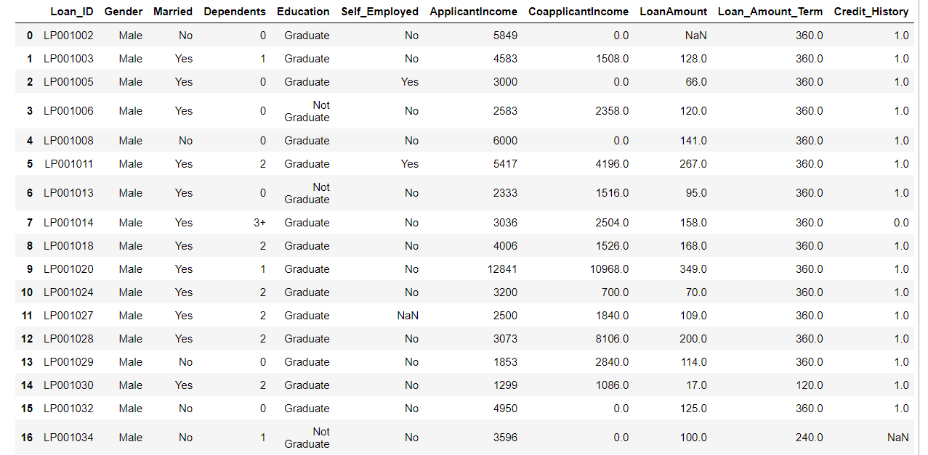
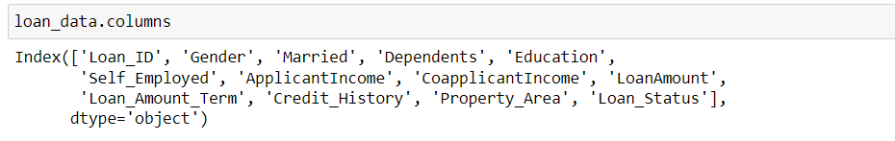
Gathering data

Slide 7
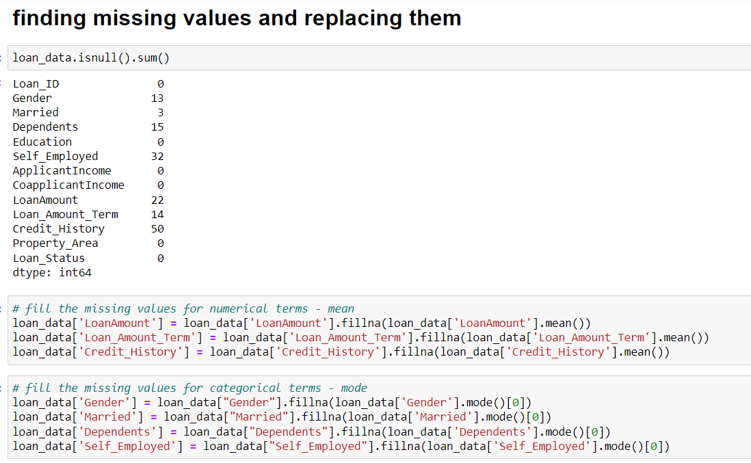
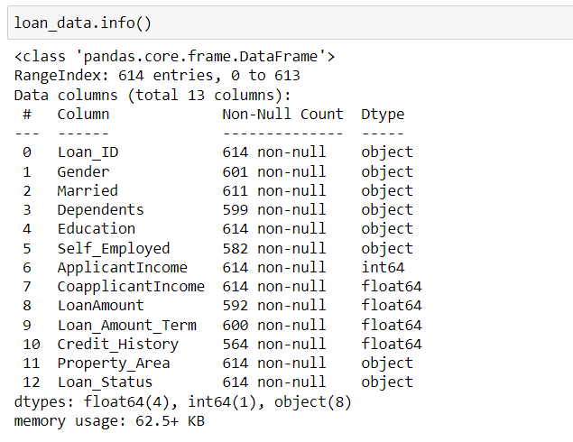
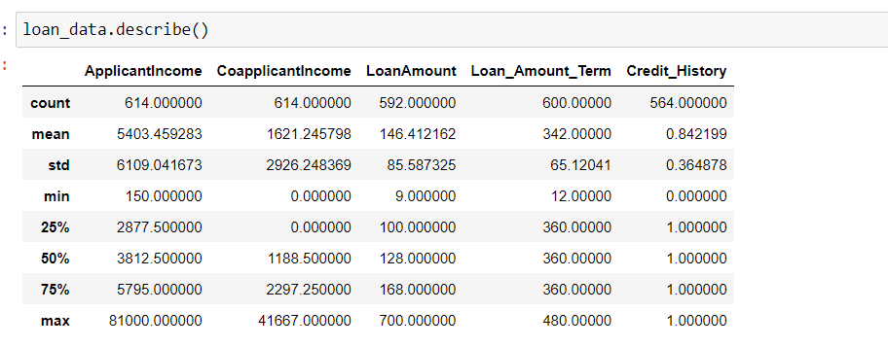
Exploratory Data Analysis

Slide 8
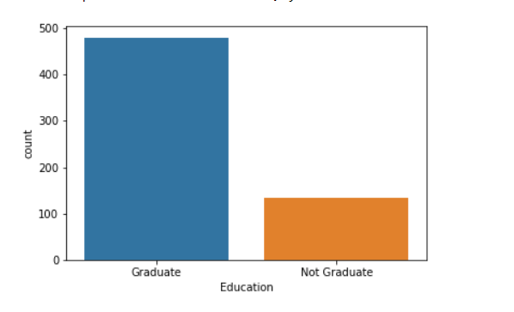
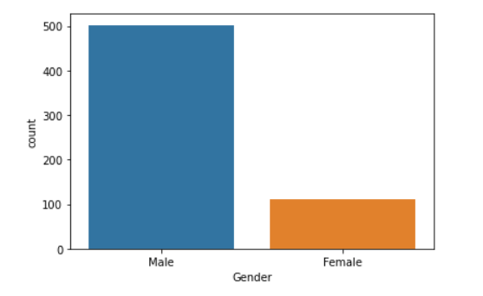
Data Visualization

Slide 9
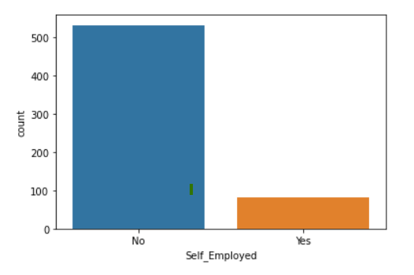
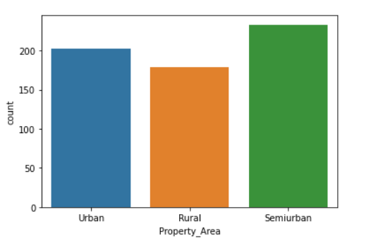
Data Visualization

Slide 10
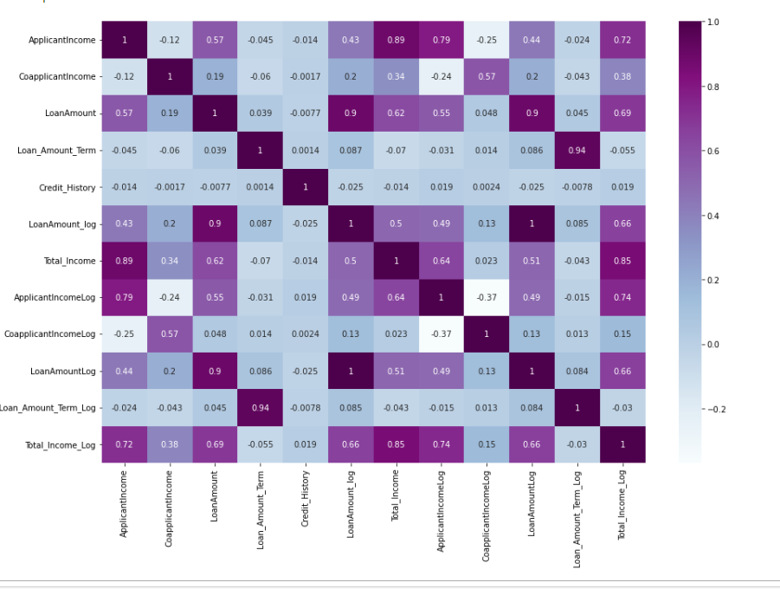
Data Visualization

Slide 11
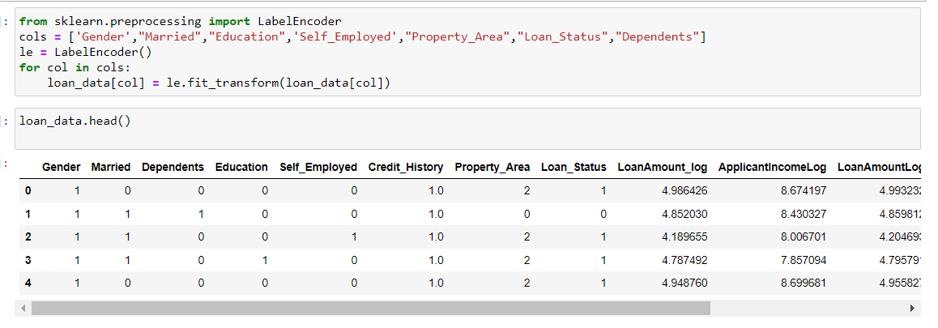
Encoding categorical data

Slide 12
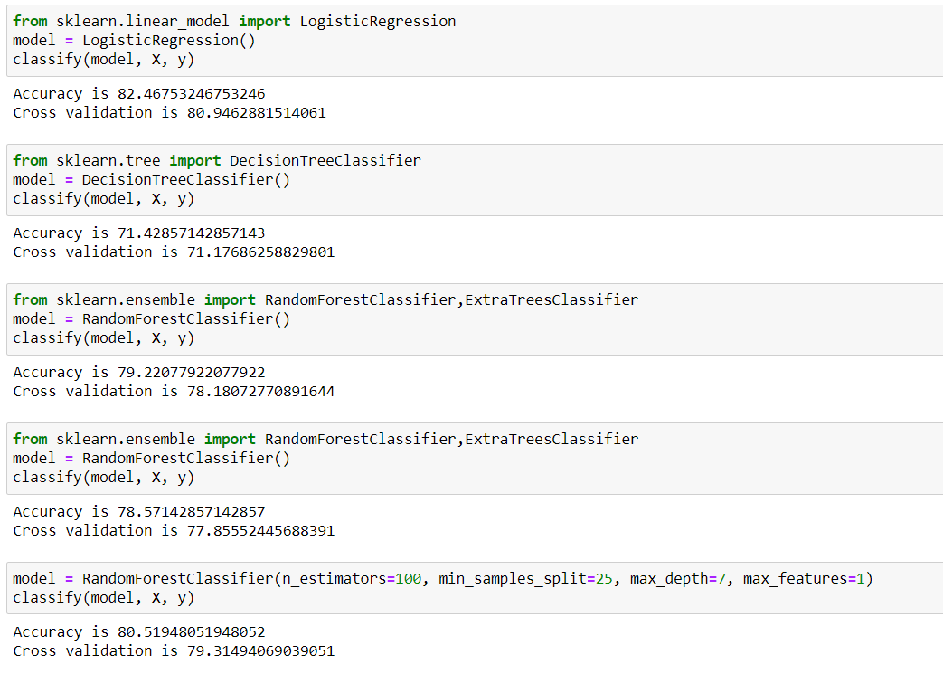
Machine Learning Model Decision
Accuracy is a metric used in classification problems used to tell the percentage of accurate predictions.
Cross-validation is primarily used in applied machine learning to estimate the skill of a machine learning model on unseen data.

Slide 13
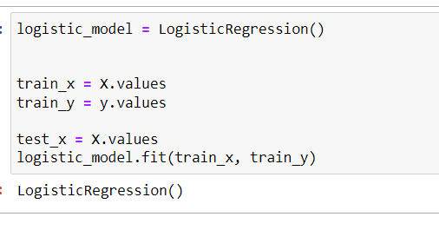
Training the ML Model
To train an ML model, you need to specify the following:
Input training data source
Name of the data attribute that contains the target to be predicted
Required data transformation instructions
Training parameters to control the learning algorithm

Slide 14
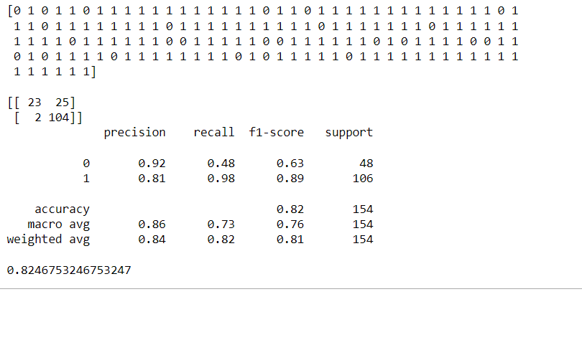
Predict the Model

Slide 15
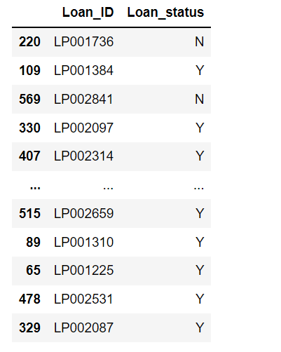
Final Result
I want a final result as a loan ID and Loan status.
So replace the data present as 0 & 1 as Y for yes and N for no.

Slide 16
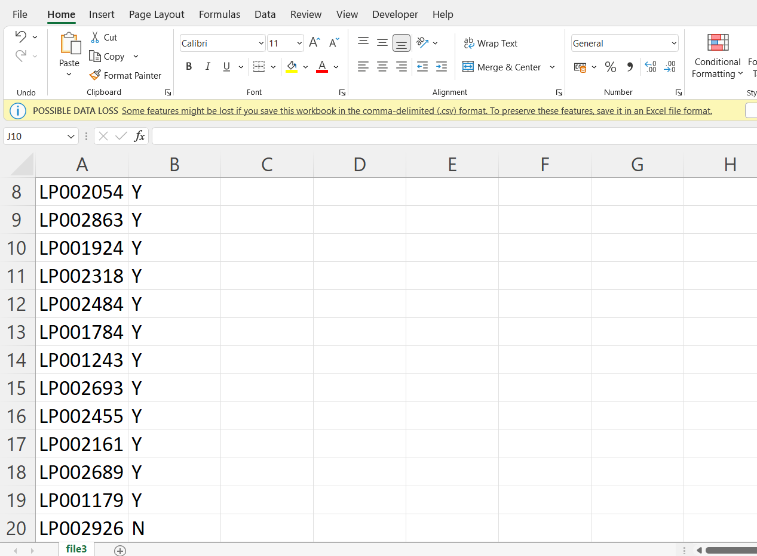
Save result as a CSV file

Slide 17


Slide 18


